Slide 1





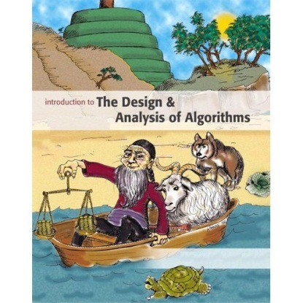



Introduction to
Algorithm Design and Analysis
[1] Model of Computation
Yu Huang
http://cs.nju.edu.cn/yuhuang Institute of Computer Software Nanjing University

Slide 2

Course Information
Syllabus
Textbook
Website

Slide 3

Syllabus
Algorithm design & analysis techniques
Model of Computation
Computation complexity

Slide 4















Syllabus
Model of
Asymptotics
Recursion
Tutorial 1
Computation
Sorting
Tutorial 2
Selection
Searching
Solutions to problems
Mid-term exam
Tutorial 3

Slide 5








Syllabus
Graph
Graph Optimization:
Graph Optimization:
Tutorial 5
traversal
MST
Shortest Path
Dynamic
String
Tutorial 6
Tutorial 7
programming
matching
Solutions to problems
NPC
Tutorial 8
Final exam

Slide 6


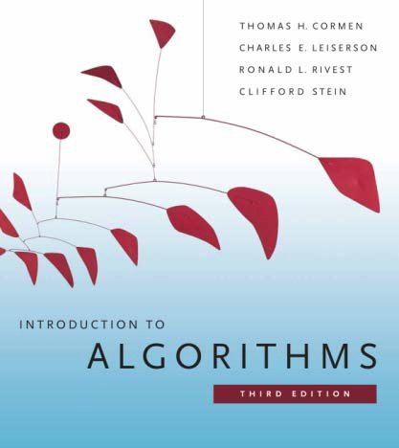
Textbooks
Course outline: LADA
Lectures on Algorithm Design & Analysis (slides)
Course contents
Introduction to Algorithms (CLRS)

Slide 7

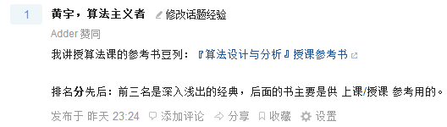

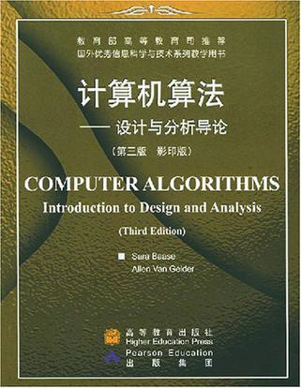
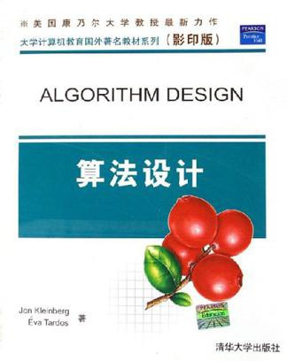
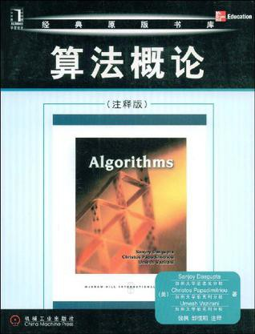
Textbooks
Further reading
Algorithms
Algorithm Design
Computer Algorithms*
See the “douban list” for more info: http://book.douban.com/doulist/1155824/

Slide 8





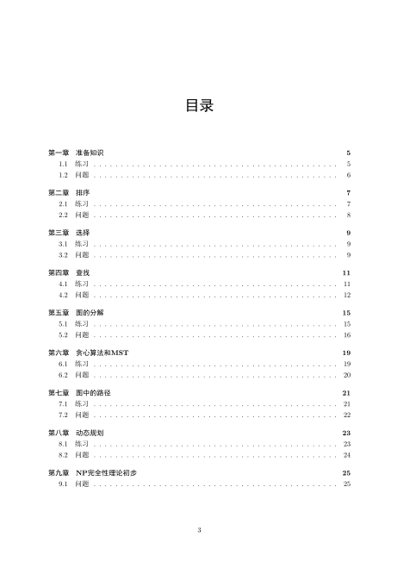
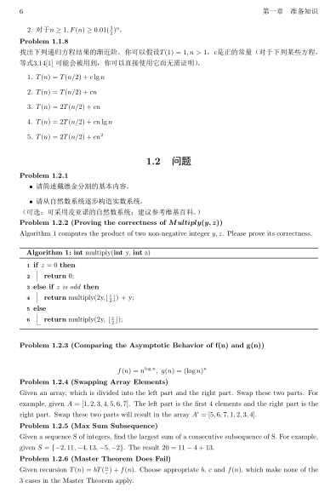
Problem Sets
Exercises
Course contents
Problems
Problem solving

Slide 9



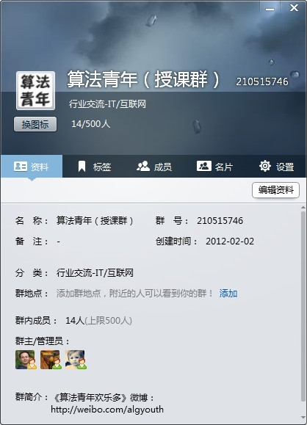
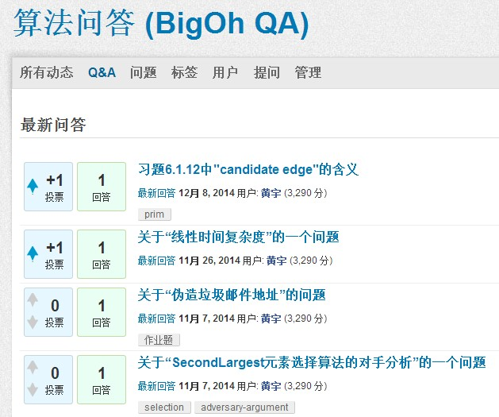
Websites
QQ group: 2105 15746
QA site: http://bigoh.net

Slide 10



Algorithm – Design & Analysis
Algorithm - the spirit of computing
Model of computation
Algorithm by example
Greatest common divisor
Sequential search
Algorithm design & analysis
Correctness
Worst-case / average-case cost analysis

Slide 11




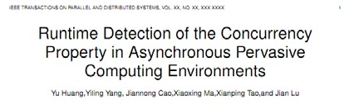



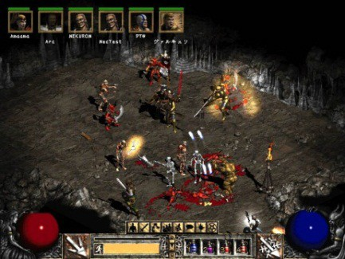

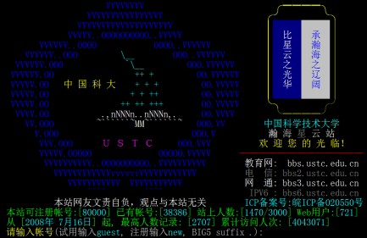
Computer and Computing
Problem 1
Why the computer seems to be able to do anything?
Scientific computing, document processing, computer games, EBooks, Movies, Computer games, …

Slide 12
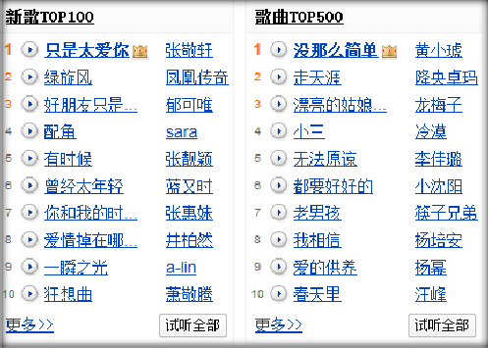
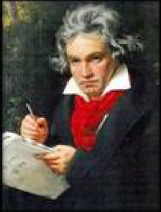
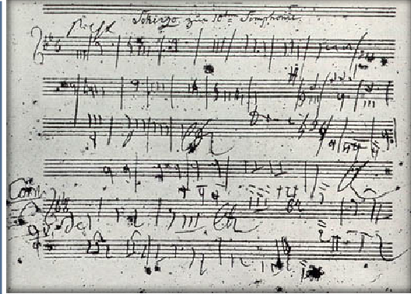
Computer and Computing
Problem 2
What can / cannot be efficiently done by a computer?
manage millions of songs vs. music composition

Slide 13
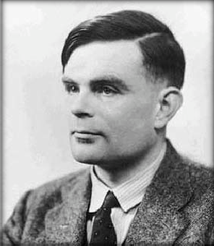
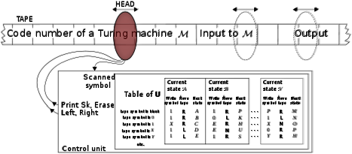
Computer and Computing
Computing
Encoding everything into `0’s and `1’s
Operations over ’1’s and ‘0’s
Decoding the ’1’s and ‘0’s
Turing machine
An abstract/logical computer

Slide 14
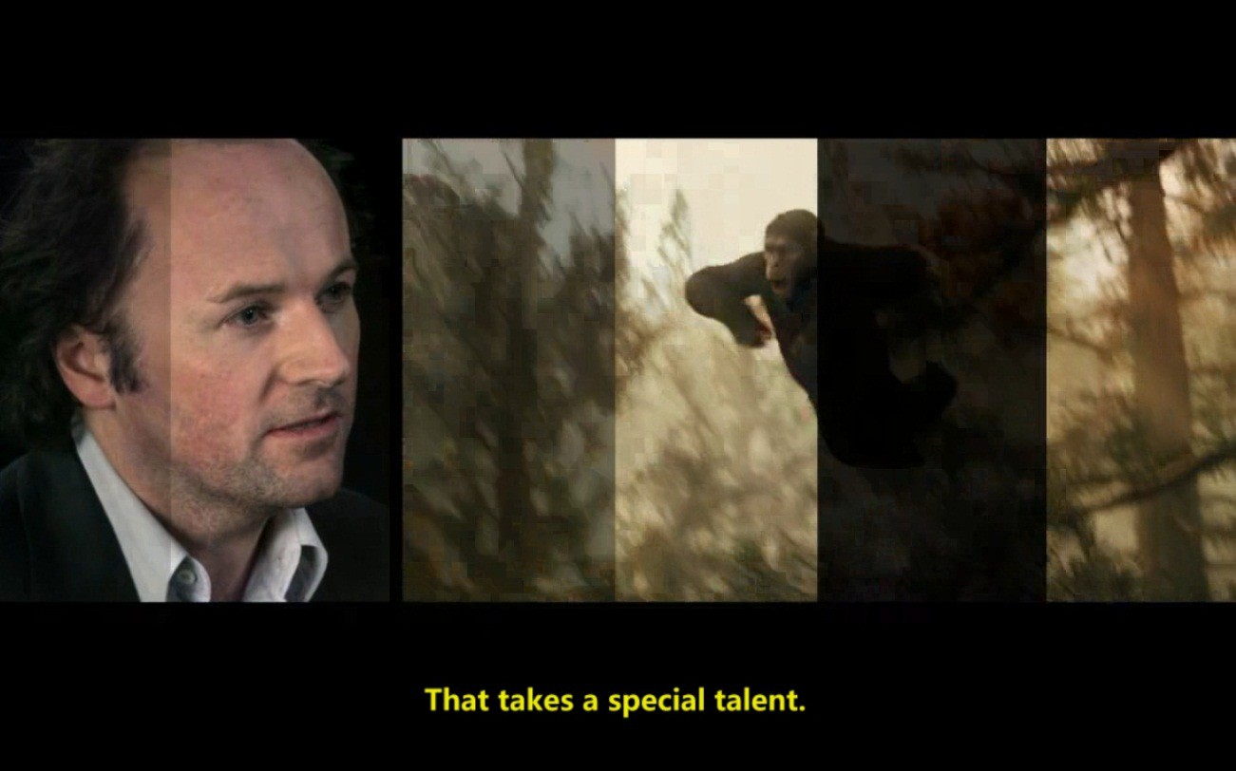
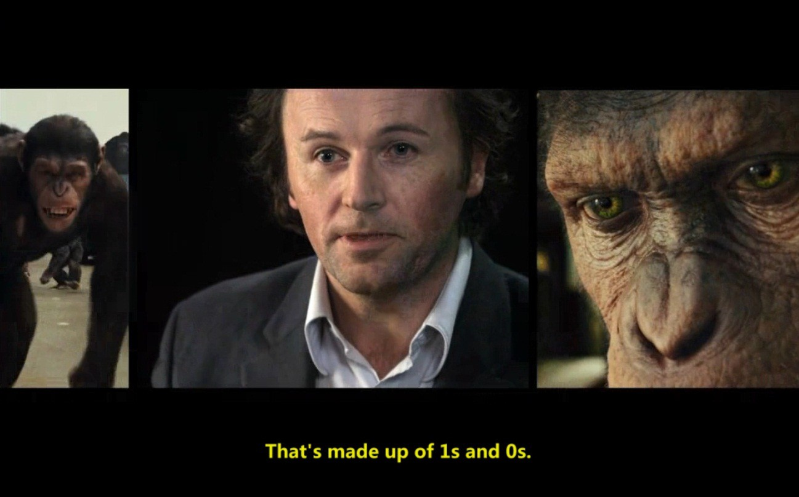
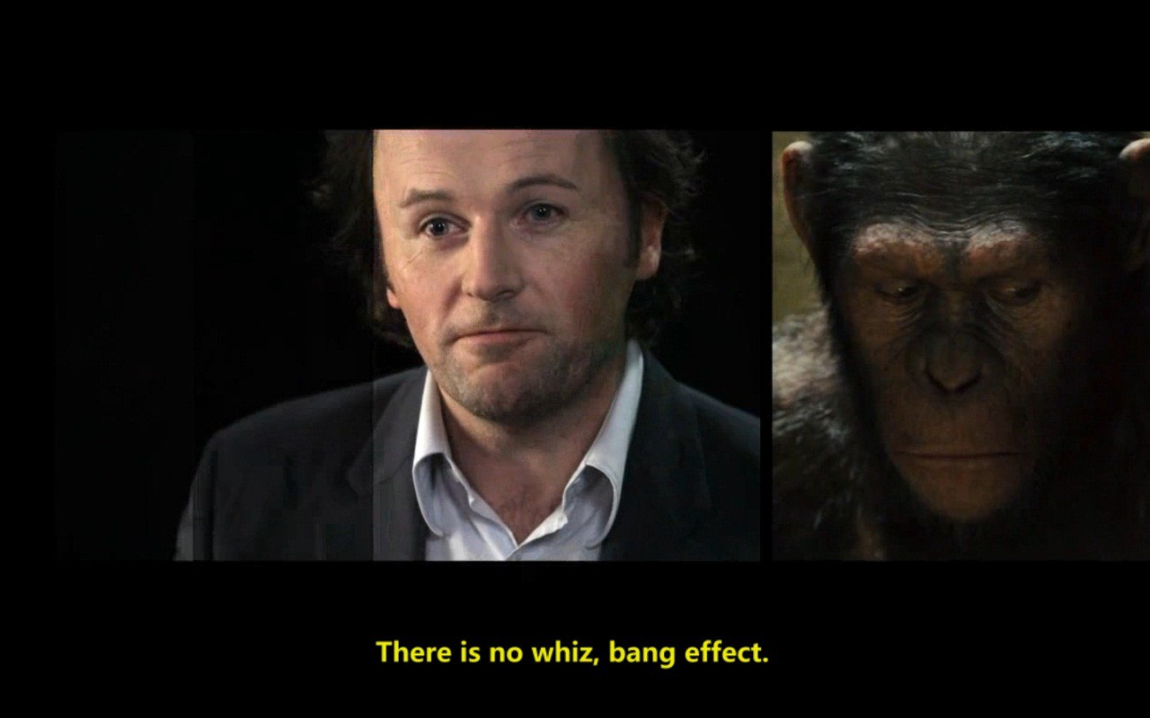
Computing in Everyday Life

Slide 15

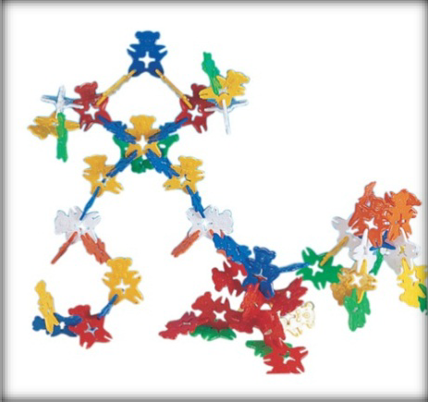
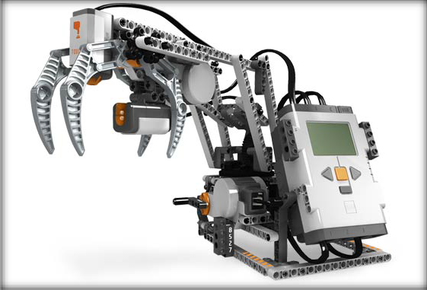
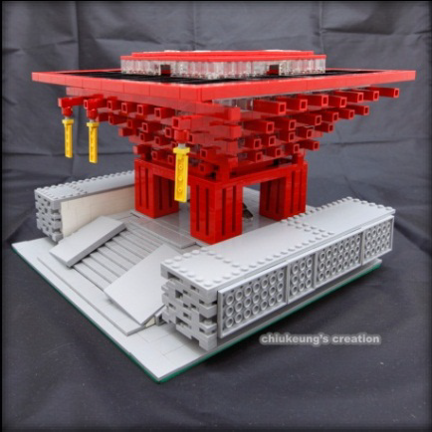
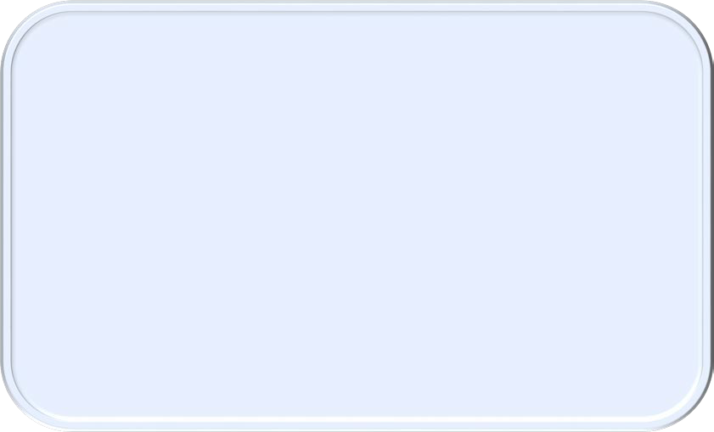
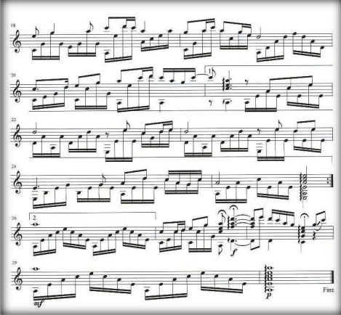

Algorithm
Rebuild the world with 0s and 1s

Slide 16

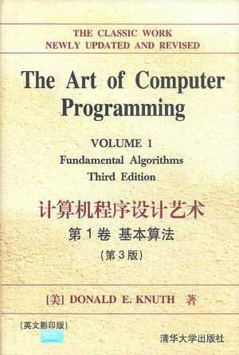
Algorithm
Algorithm is the spirit of computing
To solve a specific problem (so called an algorithmic problem)
Combination of basic operations
in a precise and elegant way
Essential issues
Model of computation
Algorithm design
Algorithm analysis

Slide 17

Model of Computation
Problems
Why the algorithms we learn can run almost everywhere?
Why the algorithms we learn can be implemented in any language?
Machine- and language- independent algorithms, running on an abstract machine
Turing machine: over-qualify
RAM model: simple but powerful

Slide 18




RAM Model
x₁ | x₂ | … | x_{n}
Read-only input tape
r₀ r₁ r₂ r₃
…
Accumulator
Location counter
Program
Memory
y₁ | y₂
Write-only output tape
…

Slide 19




The RAM Model of Computation
Each simple operation takes one time step
E.g., key comparison, +/-, memory access, …
Non-simple operations should be decomposed
Loop
o Subroutine
Memory
Memory access is a simple operation
Unlimited memory
Tradeoff: accuracy vs.
ease of use

Slide 20

Further Reading
“哼，你让他们成楔形攻击队形不就行了？”秦始皇轻蔑地看着冯·诺伊曼。 牛顿不知从什么地方掏出六面小旗．三白三黑，冯·诺伊曼接过来分给三名 士兵，每人一白一黑，说：“白色代表0，黑色代表1。好，现在听我说，出， 你转身看着入1和入2，如果他们都举黑旗，你就举黑旗，其他的情况你都举 白旗，这种情况有三种：入l白，入2黑；入l黑，入2白；入1、入2都是白。”
“不需要，我们组建一千万个这样的门部件，再将这些部件组合成一个系统， 这个系统就能进行我们所需要的运算，解出那些预测太阳运行的微分方程。 这个系统，我们把它叫做……嗯，叫做……”
“计算机。”汪淼说。
“啊——好！”冯·诺伊曼对汪淼竖起一根指头，“计算机，这个名字好， 整个系统实际上就是一部庞大的机器，是有史以来最复杂的机器！”
刘慈欣，《三体、牛顿、冯·诺依曼、秦始皇、三日连珠》，《三体》第一部

Slide 21

To Create an Algorithm
Algorithm design
Composition of simple operations, to solve an algorithmic problem
Algorithm analysis
Amount of work done / memory used
In the worst/average case
Advanced issues
Optimality, approximation ratio, …

Slide 22

Algorithm by Example
Algorithmic Problem 1
Find the greatest common divisor of two non- negative integers m and n
Algorithmic Problem 2
Is a specific key K stored in array E[1..n]?

Slide 23





Probably the Oldest Algorithm
Specification
Euclid Algorithm
Input: non-negative integer m, n Output: gcd(m, n)
Euclid algorithm
Problem
Find the greatest common divisor of two non-negative integers m and n
[E1] n divides m, the remainder -> r [E2] if r = 0 then return n
[E3] n -> m; r-> n; goto E1
Euclid algorithm – recursive version
Euclid(m,n)
[E1] if n=0 then return m
[E2] else return Euclid(n, m mod n)
Lectures on Algorithm Design & Analysis (LADA) 2015
2015/2/28 23

Slide 24



Sequential Search
Specification
Input: K, E[1..n]
Output: Location of K (1,2,…,n; -1: K is not in E[])
Problem
Search an array for a specific key
Sequential searchEuclid algorithm
Int seqSearch(int[] E, int n, int K) int ans, index;
ans=-1;
for (index=1; index<=n; index++) if (K==E[index])
ans=index; break;
Return ans;

Slide 25

Algorithm Design
Criteria
Defining correctness
Main challenge
For proving correctness
Our strategy
Mathematical induction
…
Specification
Input: non-negative integer m, n Output: gcd(m, n)
Main challenge
The output is always correct, for any
legal input.
Infinite possible inputs
Mathematical induction
Weak principle
Strong principle

Slide 26



For Your Reference
Mathematical induction
The Weak Principle of Mathematical Induction
If the statement p(b) is true and the statement p(n-1) => p(n) is true for all n>b, then p(n) is true for all integers n>=b.
The Strong Principle of Mathematical Induction
If the statement p(b) is true, and the statement {p(b) and p(b+1) and … and p(n-1) => p(n)} is true, for all n>b, then p(n) is true for all integers n>=b.

Slide 27






Correctness of the Euclid Algorithm
Induction on n
Base case
n = 0: for any m, Euclid(m, 0) = m;
n = 1: for any m, Euclid(m, 1) = 1;
n = 2: …
Assumption
For any n<=N₀, Euclid(m, n) is correct;
Induction
Euclid(m, N₀+1) = Euclid(N₀+1, m mod (N₀+1) );
gcd(m, N₀+1) = gcd(N₀+1, m mod (N₀+1) )

Slide 28



Notes on Mathematical Induction
“Notes on Structured Programming”, E.W. Dijkstra
I have mentioned mathematical induction explicitly, because it is the only pattern of reasoning that I am aware of, that eventually enables us to cope with loops and recursive procedures

Slide 29

Algorithm Analysis
Criteria
Performance metrics
Worst case
Best case?
Average case
Average cost?
Advanced topics
Lower bound, optimality, …

Slide 30
Algorithm Analysis
How to measure
Not too general
Giving essential indication in comparison of algorithms
Not too precise
Machine independent
Language independent
Programming paradigm independent
Implementation independent

Slide 31

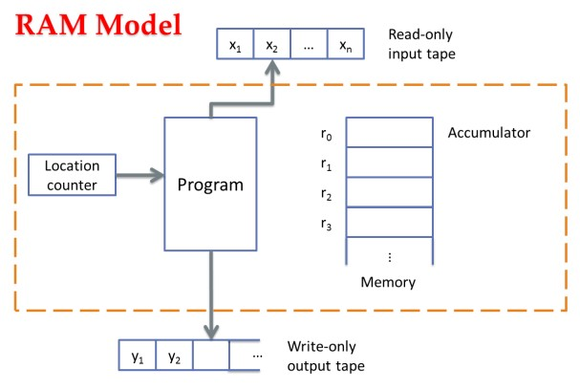
Algorithm Analysis
Criteria
Critical operation
How many critical operation are conducted
For example
Algorithmic problem | Critical operation
Sorting, selection, searching String matching | Comparison (of keys)
Graph traversal | Processing a node/edge
Matrix multiplication | Multiplication

Slide 32






Algorithm Analysis
Amount of work done
o usually depends on size of the input
o usually does not depend on size of the input only
n
Size of input
f(n)
Amount of work done
Algorithm Analysis

Slide 33



Worst-case Complexity
W(n)
Upper bound of cost
For any possible input
o 𝑊𝑊(𝑛𝑛) = max 𝑓𝑓(𝐼𝐼)
𝐼𝐼∈𝐷𝐷_{𝑛𝑛}

Slide 34

Average-case Complexity
A(n)
o Weighted average
o 𝐴𝐴 𝑛𝑛 𝑓𝑓(𝐼𝐼)
^{= ∑}𝐼𝐼∈𝐷𝐷(𝑛𝑛) ^{Pr 𝐼𝐼}
A special case
Average cost
Total cost of all inputs, averaged over the input size
o 𝐴𝐴𝑣𝑣𝑣𝑣𝑣𝑣𝑣𝑣𝑣𝑣𝑣𝑣 𝑛𝑛 =
1
∑
𝑓𝑓(𝐼𝐼)
|𝐷𝐷 𝑛𝑛 |
𝐼𝐼∈𝐷𝐷(𝑛𝑛)

Slide 35





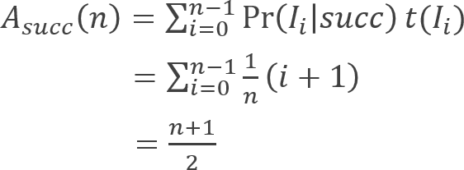
Average-case Cost of SeqSearch
Case 1: K is in E[]
o Assumptions:
Assuming that K is in E[]
Assuming no same entries in E[]
Each possible input appears with equality (thus, K in the i^{th} location with probability _{𝑛𝑛})
1
o

Slide 36





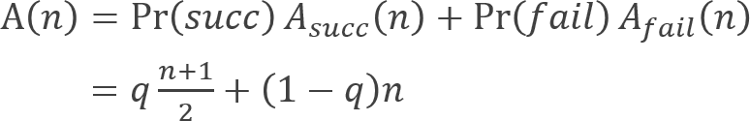


Average-case Cost of SeqSearch
Case 2: K may (or may not) be in E[]
o Assume that K is in E[] with probability q
o
How to make reasonable assumptions?

Slide 37
Algorithm Analysis
Advanced topics
Lower bound (Selection)
Optimality (Greedy, DP)
Computation complexity
Approximate / online / randomized algorithms

Slide 38




Thank you!
Q & A
Yu Huang
http://cs.nju.edu.cn/yuhuang

